Slide 1

Time Series Analysis of Retail Data
Investigating the Impact of Marketing on Sales
CSDA1040: Advance Methods of Data Analysis
Jennifer Johnson & Jessee Ho

Slide 2

Background & Context
Leveraging data analytics in the retail sector is essential for maintaining a competitive advantage in the marketplace. With time series analysis, retailers can forecast projected future revenue based on historical data and predict the impact of marketing campaigns to ensure resource optimization.
Our task is to apply time series analytics to historical retail data and develop a model to evaluate the effectiveness of marketing campaigns.

Slide 3

Analytical Solution
1.
Data Understanding and Exploration
2.
Model 1:
Validating Trends wIth ARIMA
3.
Model 2:
Predicting Marketing Campaign Results
4.
Results Discussion
5.
Deployment

Slide 4
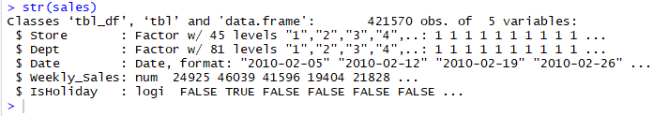
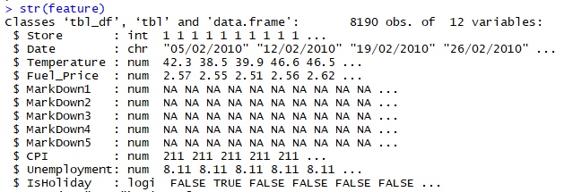
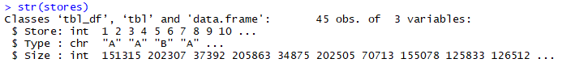
Data Understanding & Exploration
Historical sales data, which covers to 2010-02-05 to 2012-11-01.
The datasets used in our analysis are the Retail Data Analytics Datasets which contains historical sales data for 45 stores located in different regions - each store contains a number of departments.
Our analysis will focus on predicting sales outcomes from marketing campaigns, therefore we focused our analysis on the sales data. The stores dataset is useful for identifying store type which could aid in replicability of results.
Contains additional data related to the store, department, and regional activity for the given dates.
Anonymized information about the 45 stores, indicating the type and size of store

Slide 5
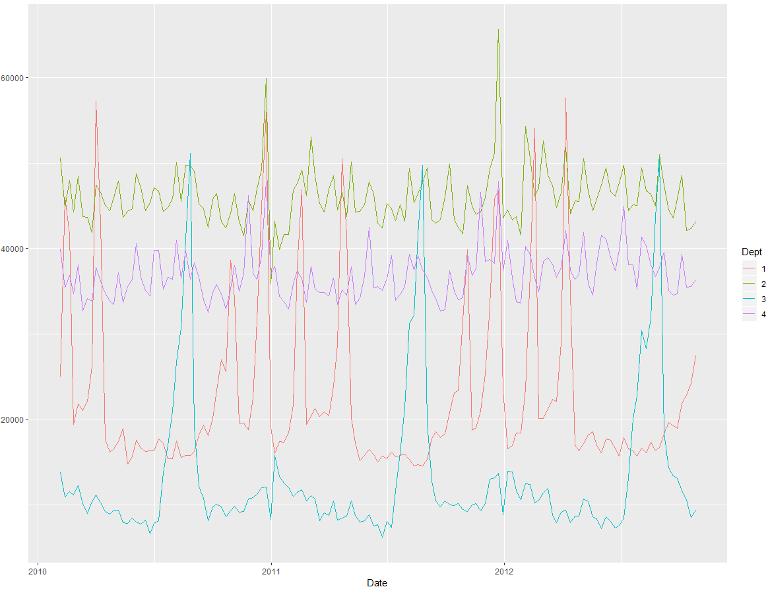
Visualizing the Data
Weekly Historical Sales by Department
The line chart on the right show the weekly sales by department from 2010 to 2012. We can see a few trends emerging.
Dept 1 (orange) - seasons sales starting around nov/oct and ending around march/apr. Implies seasonality (winter months)
Dept 2 (green) - sales peaking around christmas
Dept 3 (blue) - sales peaking every summer around june/july
Dept 4 (purple) - more even in sales, slight lift around christmas
#Visualize sales data by department
options(repr.plot.width=6, repr.plot.height=3)
ggplot(sales_s1, aes(x = Date, y = Weekly_Sales, colour = Dept)) + geom_line()

Slide 6

Model 1:
Validating Trends with ARIMA

Slide 7
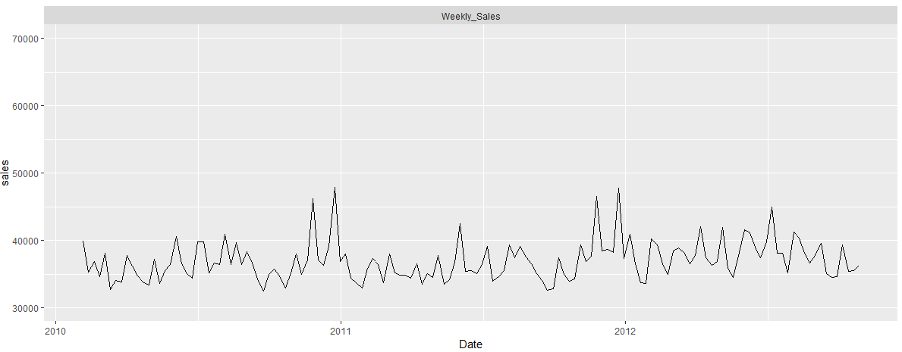
Data Preparation
#Preapring data for analysis (pull complete periods of activity for Dept 4) salesd4 <- sales_s1 %>% filter(Dept == 4)# Select department 4 only #plot department 4 2 year complete sales salesd4 %>% dplyr::select(Date, Weekly_Sales) %>% gather(type, sales, -Date) %>% ggplot(aes(x = Date, y = sales)) + geom_line() + ylim(30000, 70000) + facet_wrap(~type, ncol = 1)
Based on our discovery phase, we will be isolating Department 4 for analysis. The sales of this department are more even throughout the year have smaller seasonal peaks relative to the other departments, making it an ideal candidate for a marketing campaign.
Relative to the other departments, you can see small peaks around the year end holiday seasons. An average increase of around $25,000 in sales.
Weekly Sales for Department 4, Store 1

Slide 8
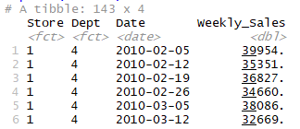
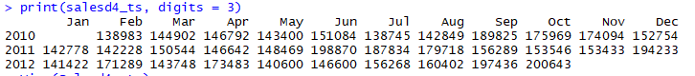
Data Transformation
#remove store and dept columns (already filtered data to be Store 1 Dept 4 only) head(salesd4_2year) salesd4 = select(salesd4, -c (Store, Dept)) #create 2 new columns Month and Year salesd4_m = salesd4 %>% mutate(month = format(Date, "%m"), year = format(Date, "%Y")) %>% group_by(month, year) %>% summarise(total = sum(Weekly_Sales)) #create time series with 12 month cycle starting Feb 2010 and ending Oct 2012 salesd4_ts <- ts(salesd4_m$total, freq = 12, start = c(2010, 2), end = c(2012, 10)) # transform to ts print(salesd4_ts, digits = 3) str(salesd4_ts)
In order to carry out ARIMA, we need to transform our data frame into a time series.
We first remove the columns Store and Dept since these are redundant after filtering for Store 1 and Dept 4.
We then create two new columns from the Date field: Month and Year
Finally, we transform the data frame into a time series with by year and month.

Slide 9
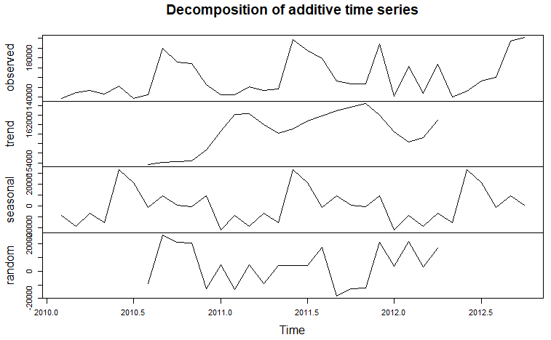
Decomposition
Using the new retail time series for department 4, we decomposed it into the trend components.
During the transformation from dataframe to time series, there was some variation in data due to the aggregation of sales. We do not feel this was a significant impact to our model since the intention of the ARIMA forecast is to only determine if the cyclical sales trends persist.
#breakdown ts into components ts = decompose(salesd4_ts) #get seasonal figures ts$figure plot(ts$figure, type="b", xaxt="n", xlab="") # get names of 12 months in English words monthNames <- months(ISOdate(2010,1:12,1)) axis(1, at=1:12, labels=monthNames, las=2) plot(ts)

Slide 10
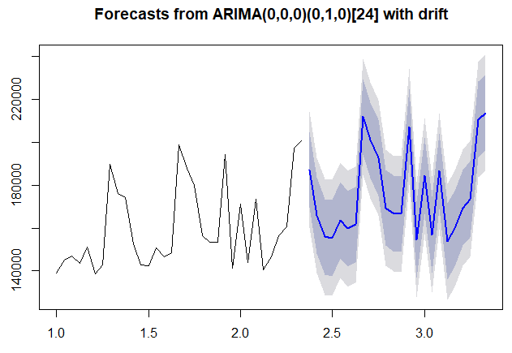
ARIMA Forecasting
Based on the ARIMA forecast, we can see that the sale pattern is forecasted to persist and that the slight upward trend identified in the decomposition persists.
We can conclude that that testing a marketing campaign on this data will yield results that are somewhat applicable to forecasted scenarios as well.
library(forecast)
fit <- arima(salesd4_ts, order=c(0,0,0), list(order=c(0,1,0), period=12))
#fit <- auto.arima(salesd4_ts)
fore <- predict(fit, n.ahead=24)
# error bounds at 95% confidence level
U <- fore$pred + 2*fore$se
L <- fore$pred - 2*fore$se
ts.plot(salesd4_ts, fore$pred, U, L, col=c(1,2,4,4),lty = c(1,1,2,2))
legend("topleft", c("Actual", "Forecast", "Error Bounds (95% Confidence)"), lty=c(1,1,2), cex=0.5)

Slide 11

Model 2:
Predicting Marketing Campaign Results

Slide 12
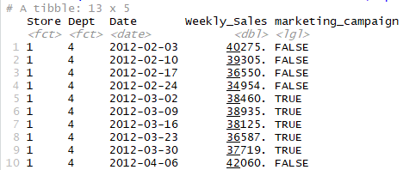
Creating a Marketing Campaign
#Create the marketing campaign period in March 2012
sales_marketing <-
sales_s1 %>%
mutate(marketing_campaign = ifelse(Dept == 4 & Date > "2012-02-28" & Date < "2012-04-01", TRUE, FALSE))#control marketing campaign here in SHINY
# Confirm Marketing Campaign is in correct period
sales_marketing %>%
filter(Date > "2012-02-01" & Date < "2012-05-01",Dept == 4)
#Adjust sales based on marketing campaign, using 30% sales increase target
sales_adj <-
sales_marketing %>%
mutate(adj_sales = ifelse(marketing_campaign == TRUE,
Weekly_Sales * 1.3,
Weekly_Sales))
Using our sale date from the previous model, we generated a sales campaign during a calm period in sales to see if we could generate a sales peak out of season.
Our campaign will take place during the month of March in 2012. Our sales target will be a 30% increase in sales which is the top end retail objective for most online campaigns.
Campaign Start
Campaign End

Slide 13
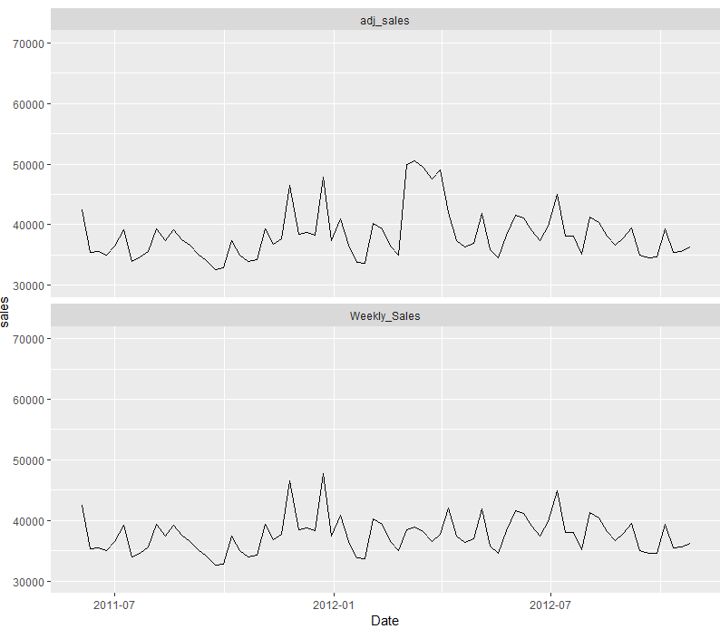
Comparing Historical Data to Marketing Campaign Projections
The first chart is the adjusted sales containing our marketing campaign. We can see that an artificial lift has been created in March when compared to the previous historical sales.
sales_adj %>%
filter(Dept == 4 & Date > "2011-06-01") %>%
dplyr::select(Date, Weekly_Sales, adj_sales) %>%
gather(type, sales, -Date) %>%
ggplot(aes(x = Date, y = sales)) +
geom_line() +
ylim(30000, 70000) +
facet_wrap(~type, ncol = 1)

Slide 14
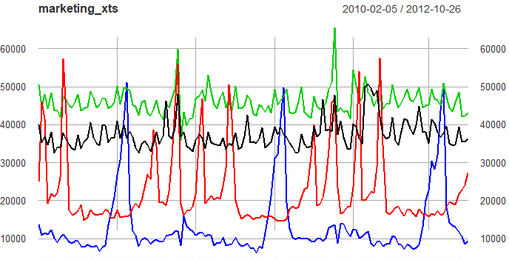
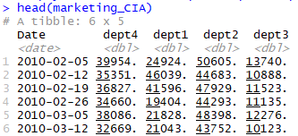
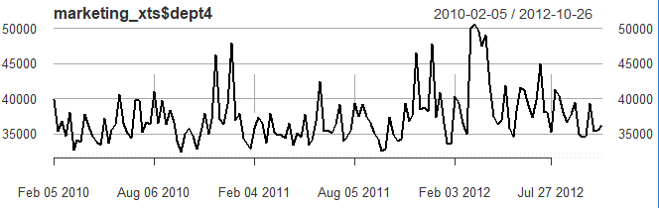
Creating Time Series for Bayesian Analysis
#Separate departments into columns marketing_CIA <- sales_adj %>% dplyr::select(Date, Dept, adj_sales) %>% spread(Dept, adj_sales) %>% rename(dept1 = 2, dept2 = 3, dept3 = 4, dept4 = 5) %>% dplyr::select(Date, dept4, dept1, dept2, dept3)
#Conver to Time Series marketing_xts <- marketing_CIA %>% dplyr::select(-Date) %>% as.xts(order.by = marketing_CIA$Date)

Slide 15
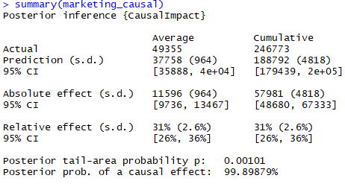
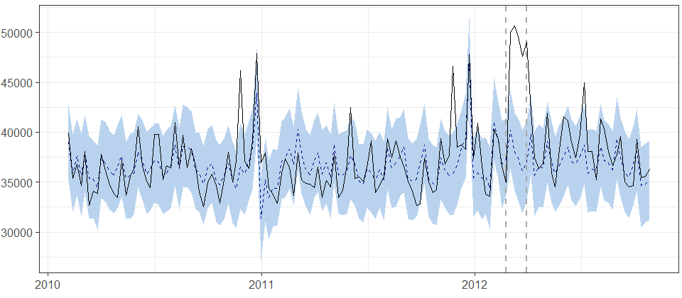
Visualization: Parallel Coordinate Plot
“...the response variable showed an increase of +31%. The 95% interval of this percentage is [+26%, +36%].”
“...the positive effect observed during the intervention period is statistically significant and unlikely to be due to random fluctuations.”
“The probability of obtaining this effect by chance is very small (Bayesian one-sided tail-area probability p = 0.001). ...causal effect can be considered statistically significant. “
# create pre sale and post periods
pre_period <- as.Date(c("2010-02-01", "2012-02-28"))
# period before marketing campaign
post_period <- as.Date(c("2012-03-01", "2012-03-31"))
#duration of marketing campaign
# Bayesian structural time series analysis Model
library(CausalImpact)
marketing_causal <- CausalImpact(marketing_xts,
pre.period = pre_period,
post.period = post_period)

Slide 16

Results Discussion
# generate summary report
summary(marketing_causal, "report")
Analysis report {CausalImpact}
Summing up the individual data points during the post-intervention period (which can only sometimes be meaningfully interpreted), the response variable had an overall value of 246.77K. By contrast, had the intervention not taken place, we would have expected a sum of 188.79K. The 95% interval of this prediction is [179.44K, 198.09K].
The above results are given in terms of absolute numbers. In relative terms, the response variable showed an increase of +31%. The 95% interval of this percentage is [+26%, +36%].
This means that the positive effect observed during the intervention period is statistically significant and unlikely to be due to random fluctuations. It should be noted, however, that the question of whether this increase also bears substantive significance can only be answered by comparing the absolute effect (11.60K) to the original goal of the underlying intervention.
The probability of obtaining this effect by chance is very small (Bayesian one-sided tail-area probability p = 0.001). This means the causal effect can be considered statistically significant.

Slide 17

Deployment

Slide 18
SHINY APP
FAQ
How useful is your model for interested parties?
The deployed model will adjustable parameters to users can customize the views required by the interested parties. This expands the scope of analysis for all retail sales types.
How would you deploy your model for interested parties?
Deployment will be via Shiny App
How often would the model need to be updated?
The model should be updated as additional transactional data becomes available to increase the amount of historical data on hand. This will further increase the strength of the ARIMA forecasting predictions as there will be more data to project with. As mentioned previously, additional data will allow for increased prediction confidence and additional scope of analysis.
*Many attributes useful for analysis were made confidential and removed in this dataset. Attributes like store type can have a significant impact on project marketing campaigns and seasonal trends.
https://crazy8girl.shinyapps.io/time-series/
CODE LOCATION: Click here to access code

Slide 19
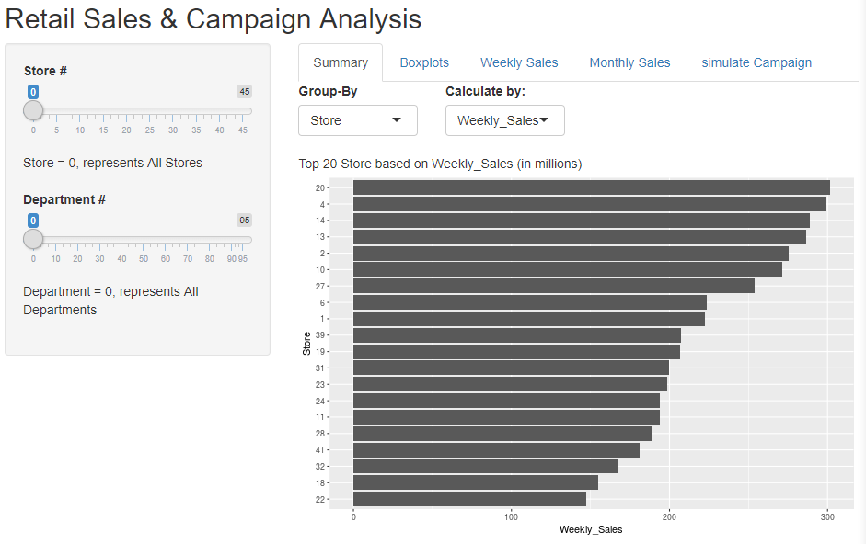
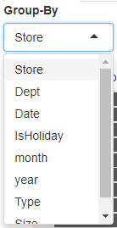
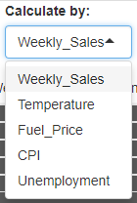
Walkthru of Shiny App

Slide 20
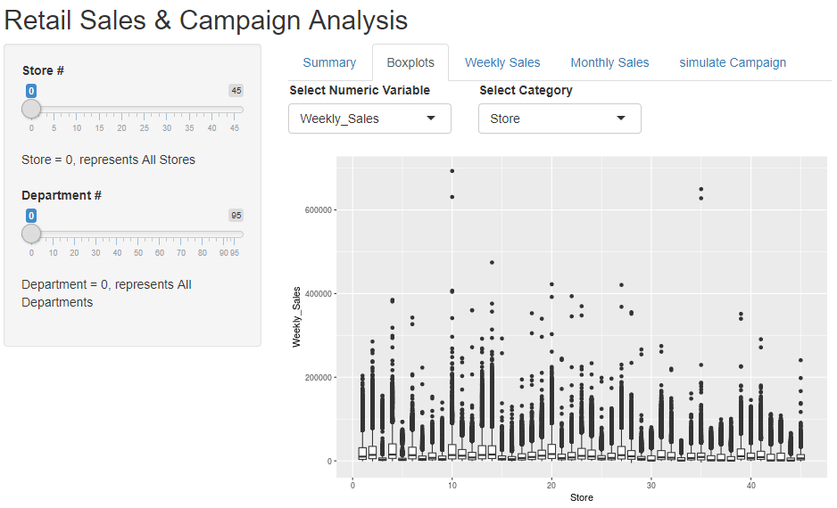
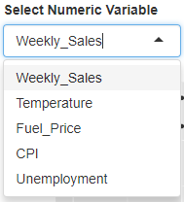
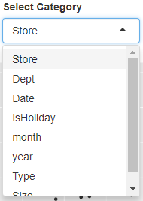
Walkthru of Shiny App

Slide 21
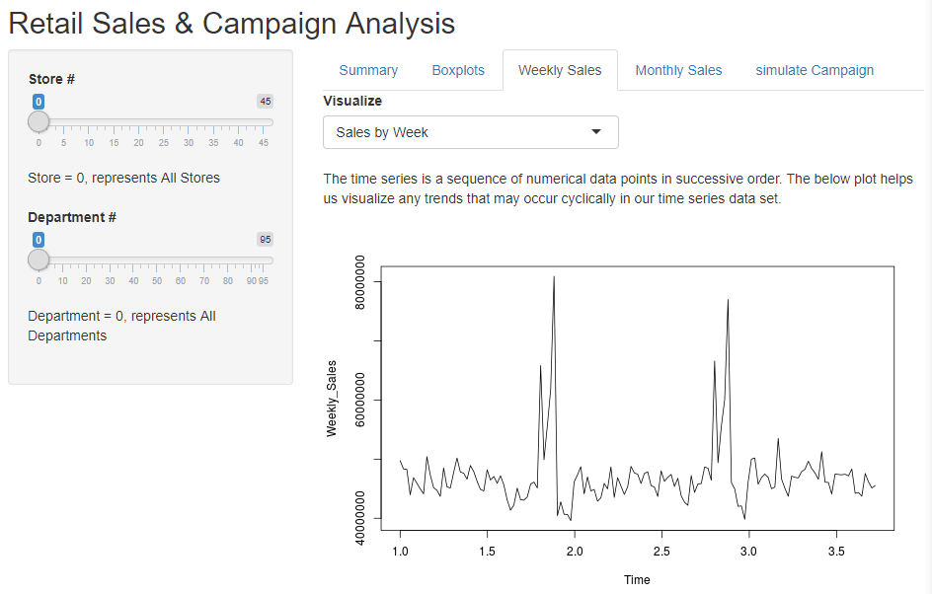
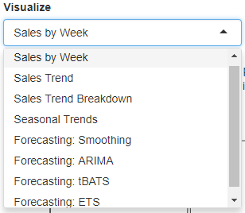
Walkthru of Shiny App

Slide 22
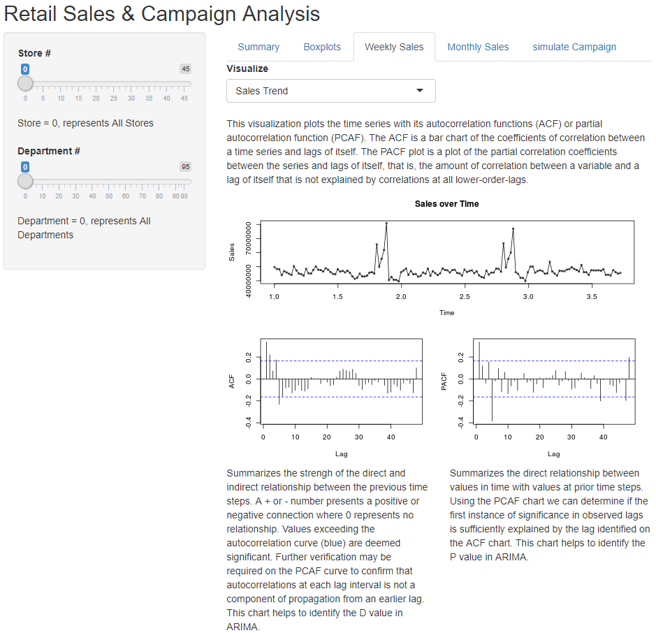
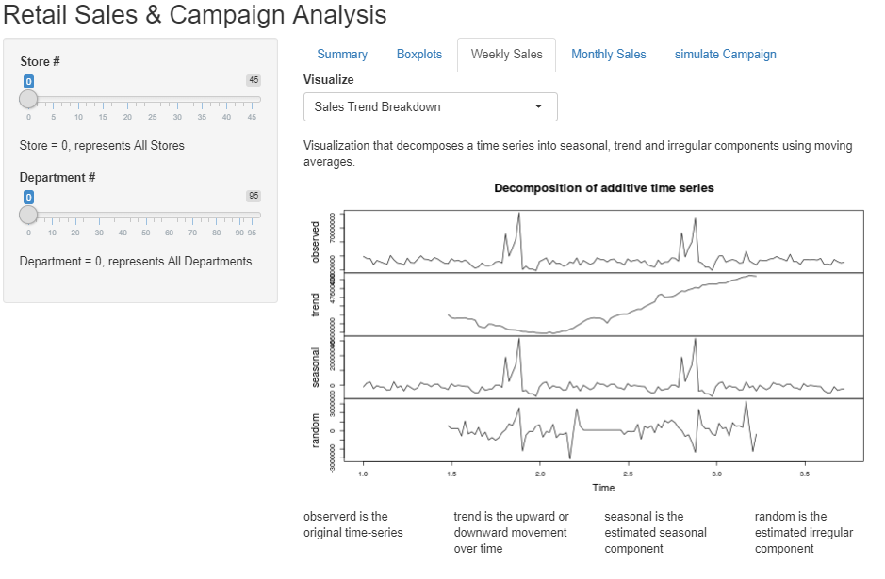
Walkthru of Shiny App

Slide 23
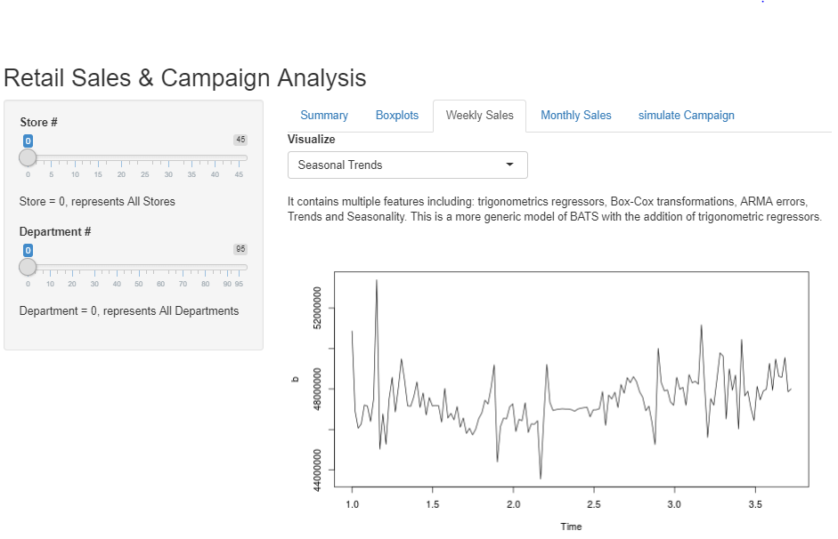
Walkthru of Shiny App

Slide 24
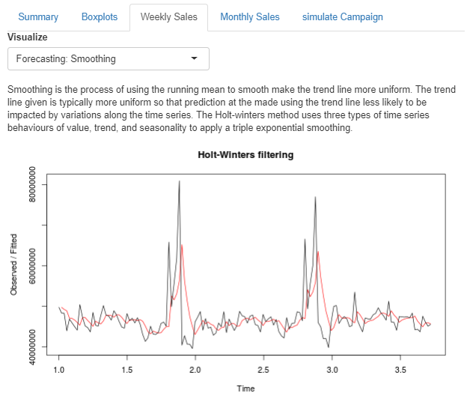
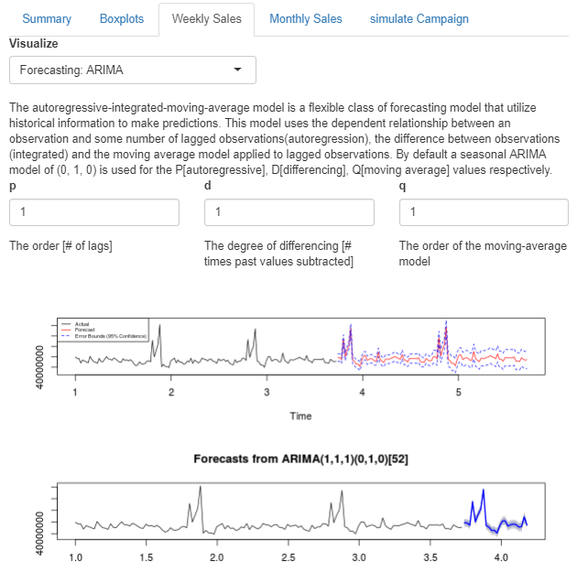
Walkthru of Shiny App

Slide 25
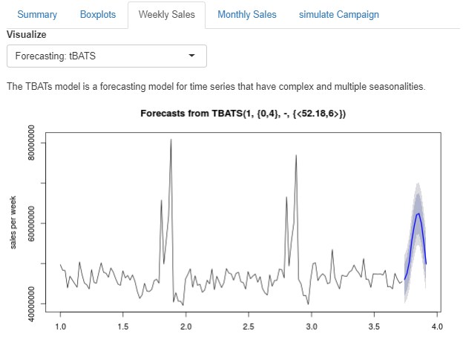
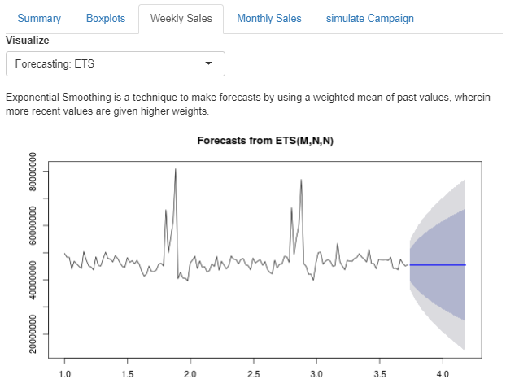
Walkthru of Shiny App

Slide 26
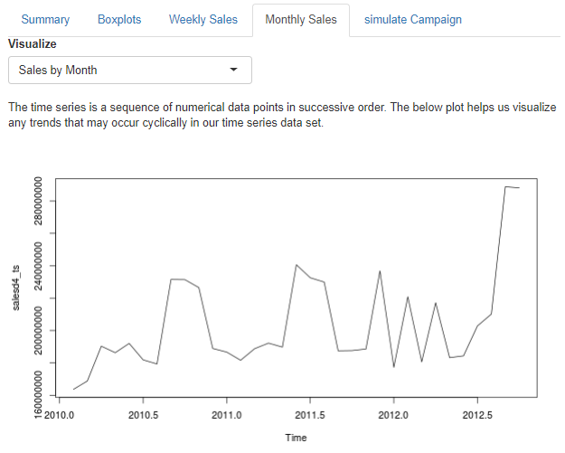
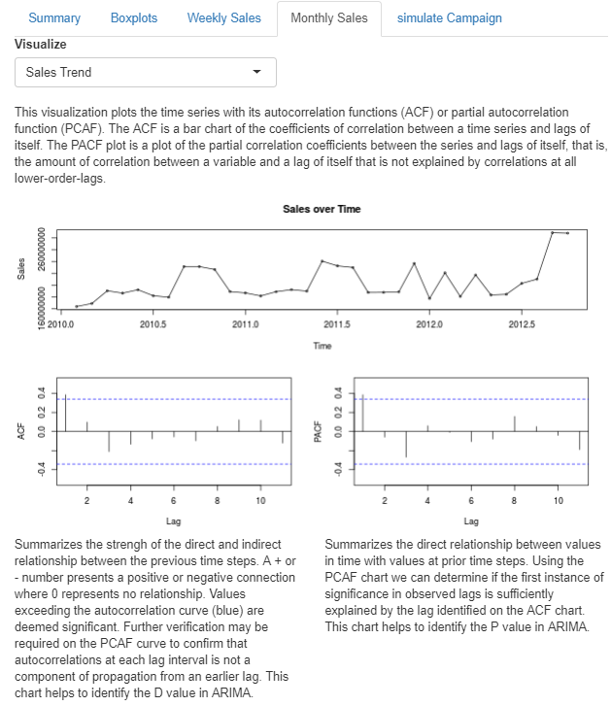
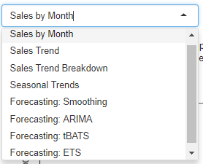
Walkthru of Shiny App

Slide 27
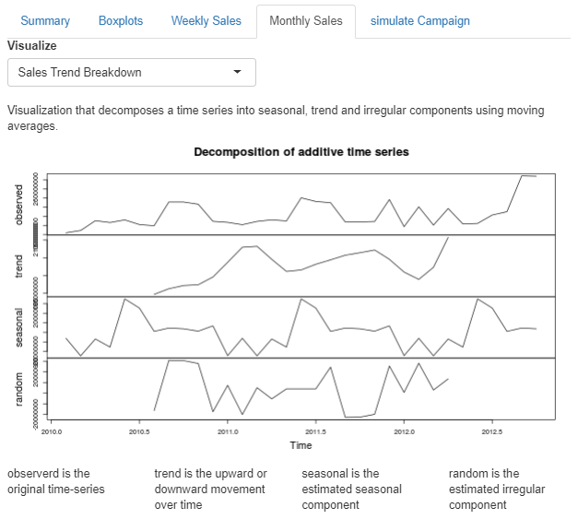
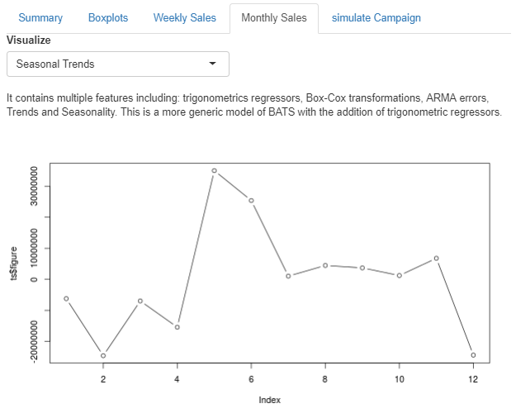
Walkthru of Shiny App

Slide 28
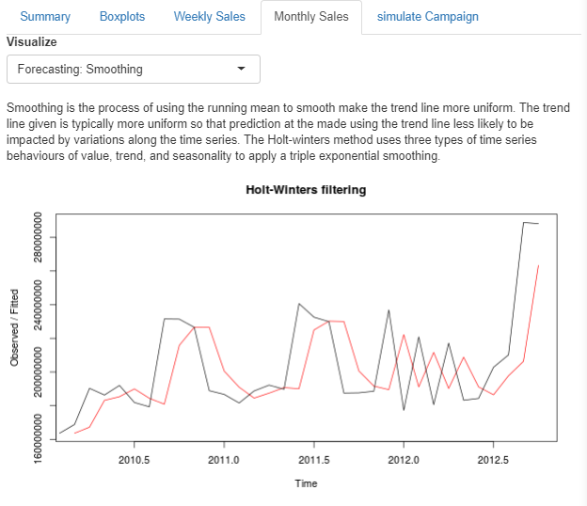
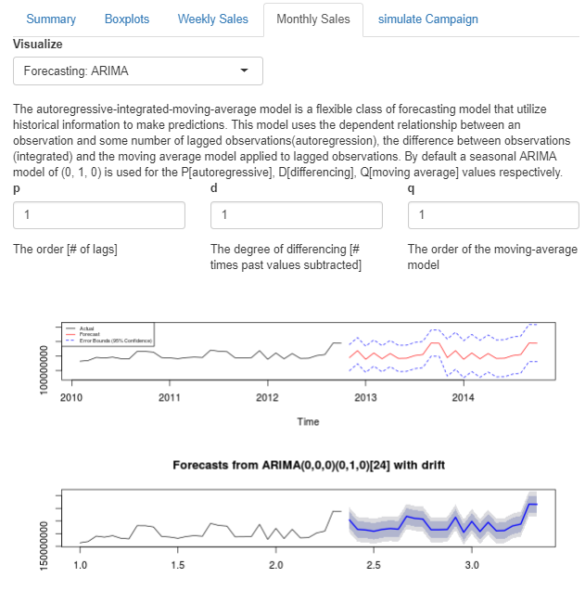
Walkthru of Shiny App

Slide 29
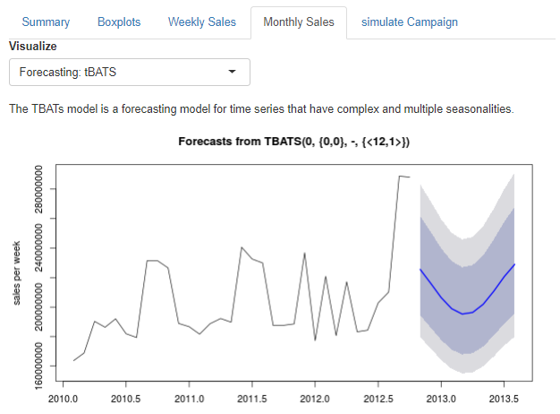
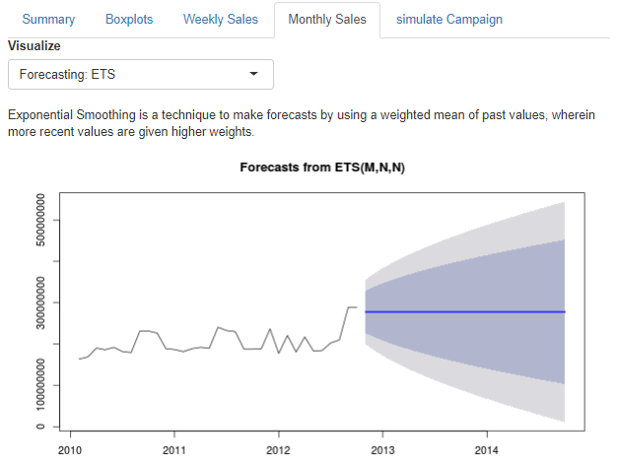
Walkthru of Shiny App

Slide 30
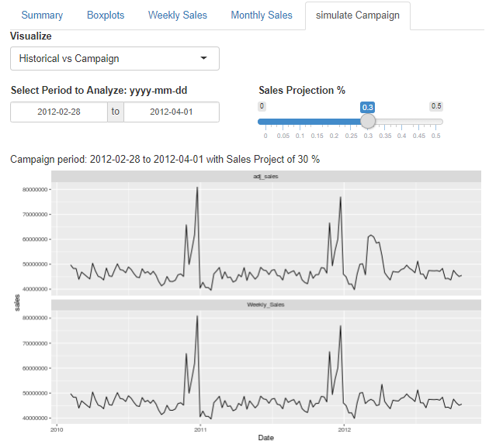
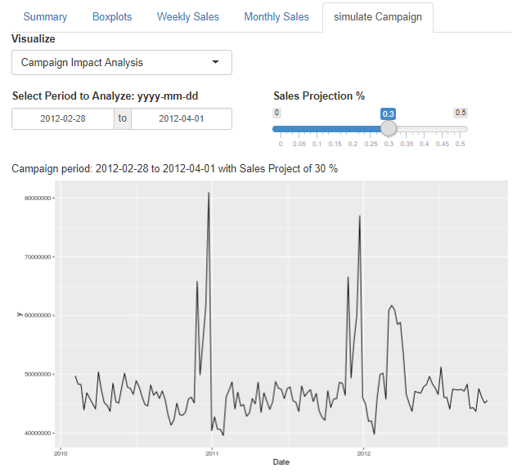
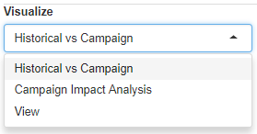
Walkthru of Shiny App

Slide 31
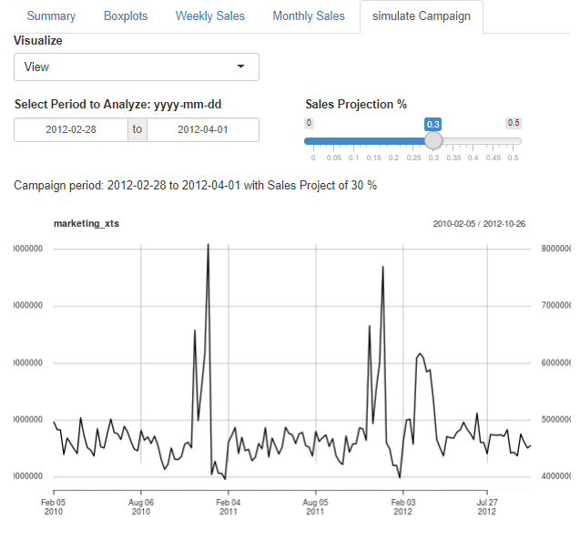
Walkthru of Shiny App

